Slide 1


Social Buzz – A Review

Slide 2


TODAY’S AGENDA
PROJECT RECAP
PROBLEM
THE ANALYTICS TEAM
PROCESS
INSIGHTS
SUMMARY

Slide 3

Social Buzz is a rapidly growing tech company that needs to adapt quickly to its global scale. To help Social Buzz, Accenture will be focusing on the following tasks over the next 3 months:
Project Recap
An audit of Social Buzz’s big data Practice
Recommendations for a successful IPO
Analysis to find Social Buzz’s top 5 popular categories of content

Slide 4

Problem
-> More than over 1 lakh posts per day
-> About 36.5 Million pieces of content per year !
We will be focusing on:
1. Capitalization of content even if it is huge
2. Analysis to find Social Buzz’s top 5 most popular categories of content

Slide 5



ANDREA FLEMMING
Chief Technical Architect
The Analytics team
MARCUS ROMPTON
Senior Principal
SRINATH SAHU
Data Analyst

Slide 6
Process
1
Understanding the Data
2
Cleaning the Data
3
Modelling the Data
4
Analysing the Data
5
Providing Insights

Slide 7
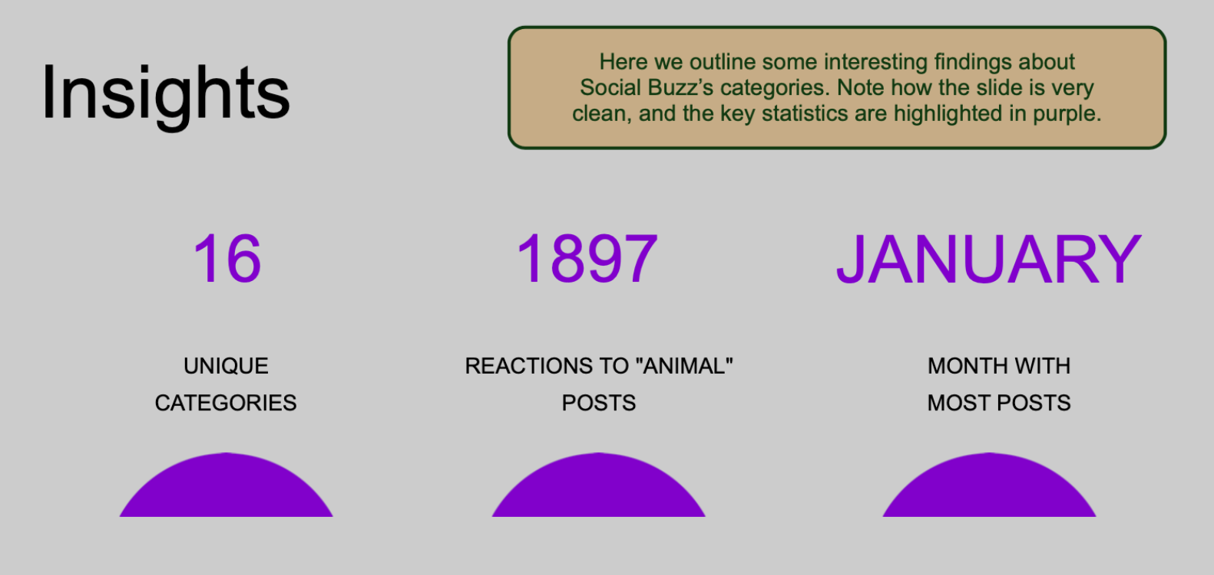

Insights

Slide 8


Slide 9
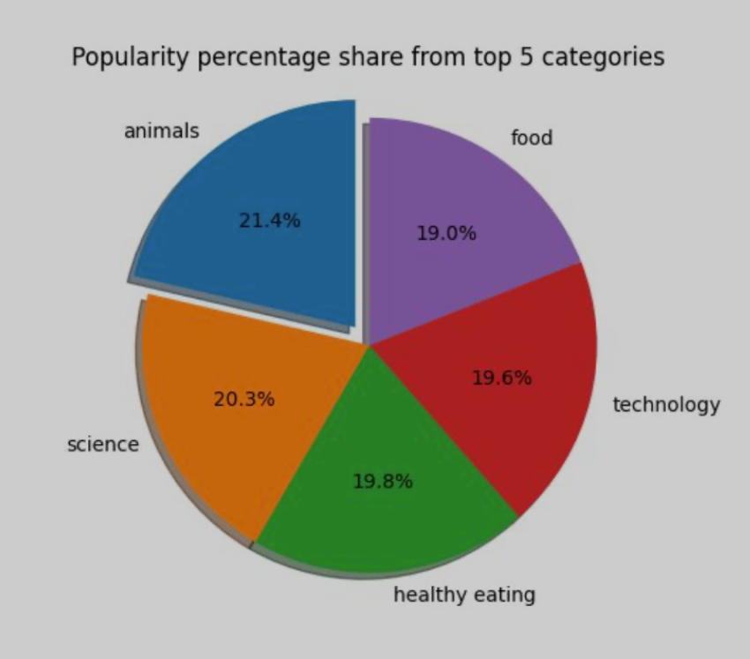

Slide 10
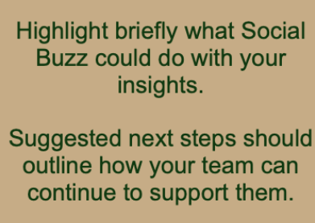
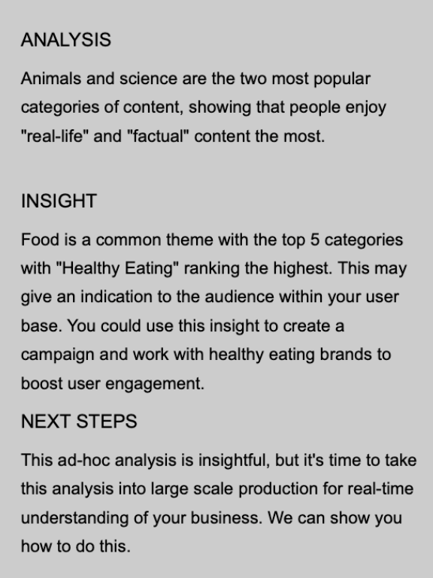

Summary

Slide 11
Thank you!
ANY QUESTIONS?

